Slide 1
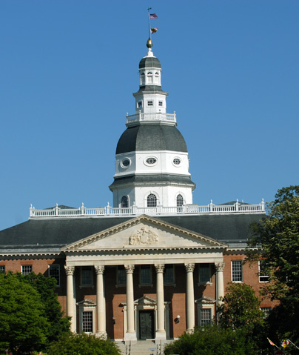

Exploring State
Of Maryland Payment Data

Slide 2






OUR TEAM
Marco Medugno
Adarsh Challa
Bharath Routhu
Junyi Wang
Naiqian Zhang
Rohit Jadhav

Slide 3


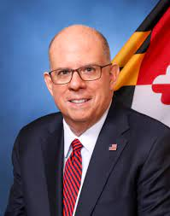
Did You Know?
The State of Maryland launched the Maryland Transparency Portal in 2018 after receiving a “D+” in a PIRG report on provision of online government spending data
One of our greatest challenges has been to find a way to convey information about the state budget that makes it easy for our citizens to understand where tax revenue is coming from, where it’s going, and why”
Larry Hogan, Governor of Maryland
Notes:
https://www.govtech.com/gov-experience/maryland-tries-fresh-approach-with-budget-transparency-portal.html

Slide 4
TABLE OF CONTENTS
OUR Preparation
OUR
Findings
01.
03.
OUR
Tools
OUR
Conclusion
02.
04.
How did we clean the data to be readable and effective when doing analysis
When did the data tell us about payments in the state of Maryland
What BI tools did we use for data analysis and data visualization
What type of data do we want to see more of in the future for better insights

Slide 5


01.
OUR Preparation
//0507 TEAM 5
MARYLAND PAYMENT EDA

Slide 6
Data Description
Fiscal Year (Number): Describes the Year in which the funding of the entry occurred.
Agency Name (String): The name of the state agency that approved the funding
Vendor Name (String): The name of the vendor to how the funds have be allocated to.
Vendor Zip (Number): Vendor Location Pincode.
Amount (Number): Payment value of the transaction
Fiscal Period (Number): The duration when the funds were dispersed in years
Date (Date): Describes the Date in which the funding of the entry occurred.
Category (String): Code for agency
Data Source : State of Maryland Payments Data: FY2008 to FY2023

Slide 7
Data Cleansing Using Pandas & Excel
Reduced the size of the dataset from 8 columns and 316,907 rows to 6 columns and 306,890 rows of data.
Got rid of the unnecessary columns such as Date and Category.
Filtered out the data from the year 2023 since a lot of it was incomplete.
Gave common names to agencies or vendors in instances where the same agency or vendor had different names in different years.
For example:
Maryland Department of Health to Maryland Department of Health, MDH
State Department of Education to Maryland State Department of Education
Joined zip codes in data set to states to understand funding distribution across 53 regions.
Notes:
https://github.com/adarshchalla/MD-Payments-Data-cleaning/blob/main/MD%20Payments%20data%20cleaning.ipynb

Slide 8
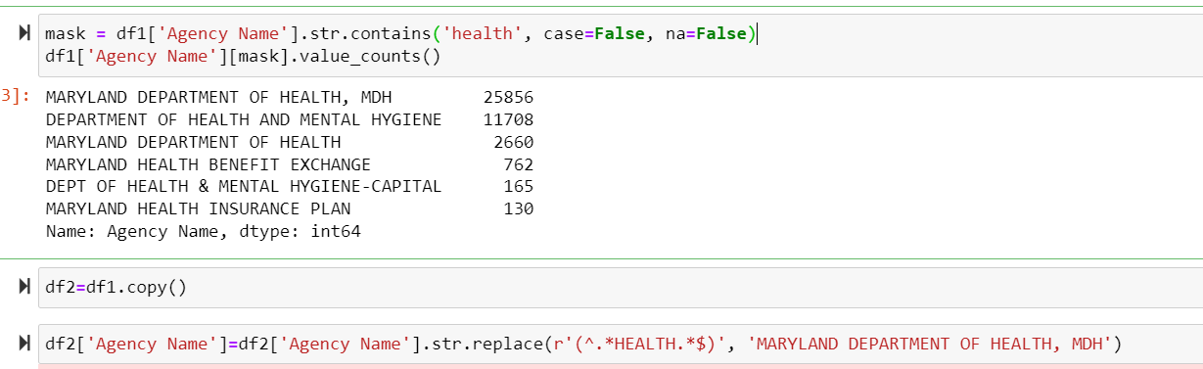
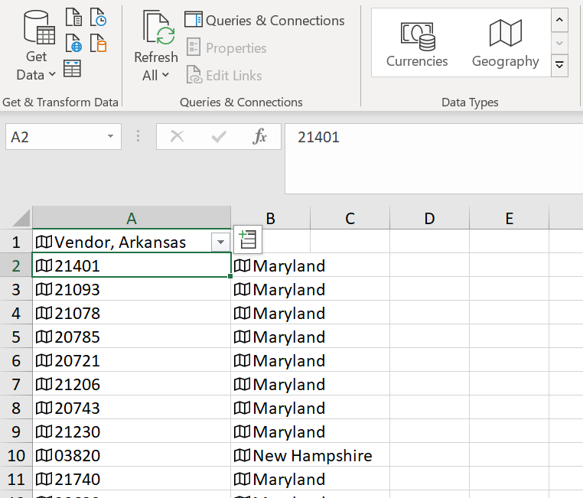
Preprocessing :
Changing the agency names for health :
Zip to State Mapping in Excel

Slide 9
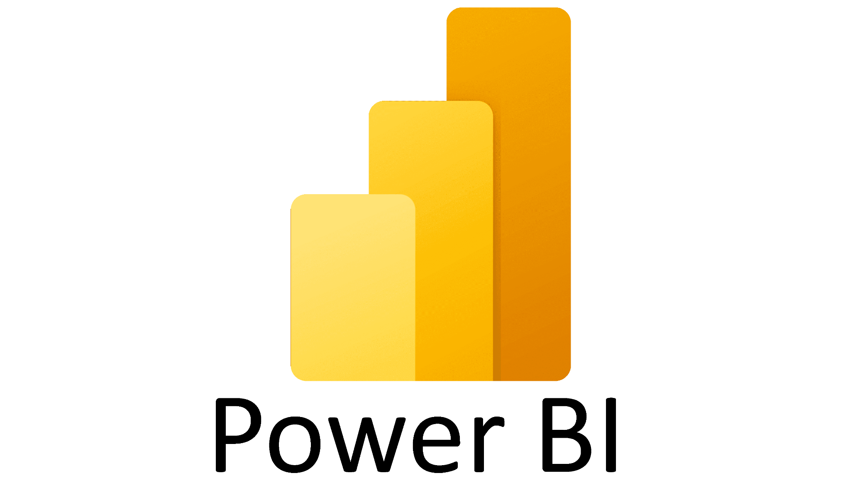



02.
OUR
Tools
//0507 TEAM 5
MARYLAND PAYMENT EDA

Slide 10

03.
OUR
Findings
//0507 TEAM 5
MARYLAND PAYMENT EDA

Slide 11
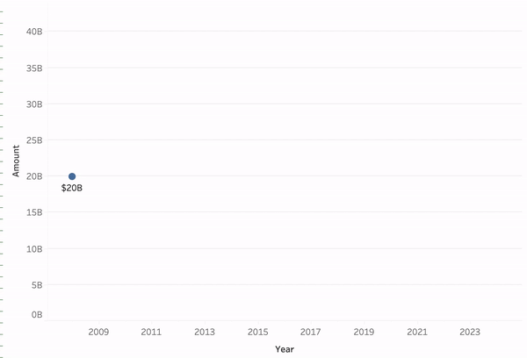
Findings-Amount
Payments have been trending upwards since 2009. By the end of fiscal year 2024, the total payment amount is expected to be $39 Billion.

Slide 12
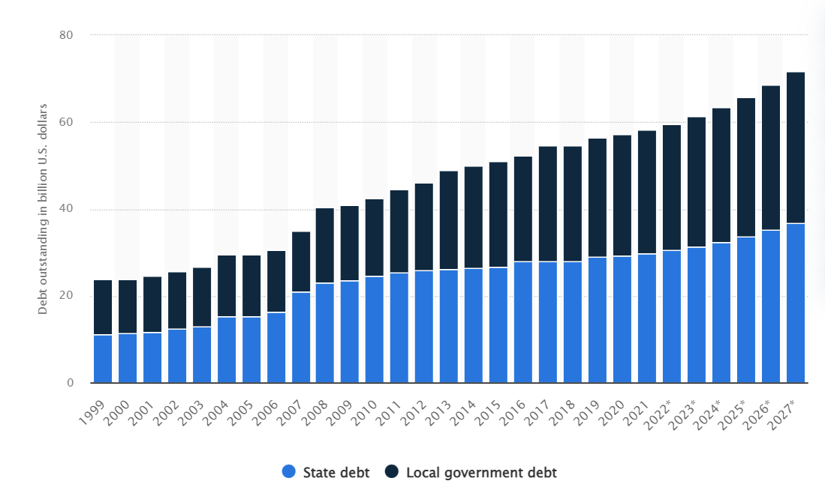
Maryland state deficit over the years
Notes:
External source of data : https://www.statista.com/statistics/590110/maryland-state-and-local-government-debt/

Slide 13
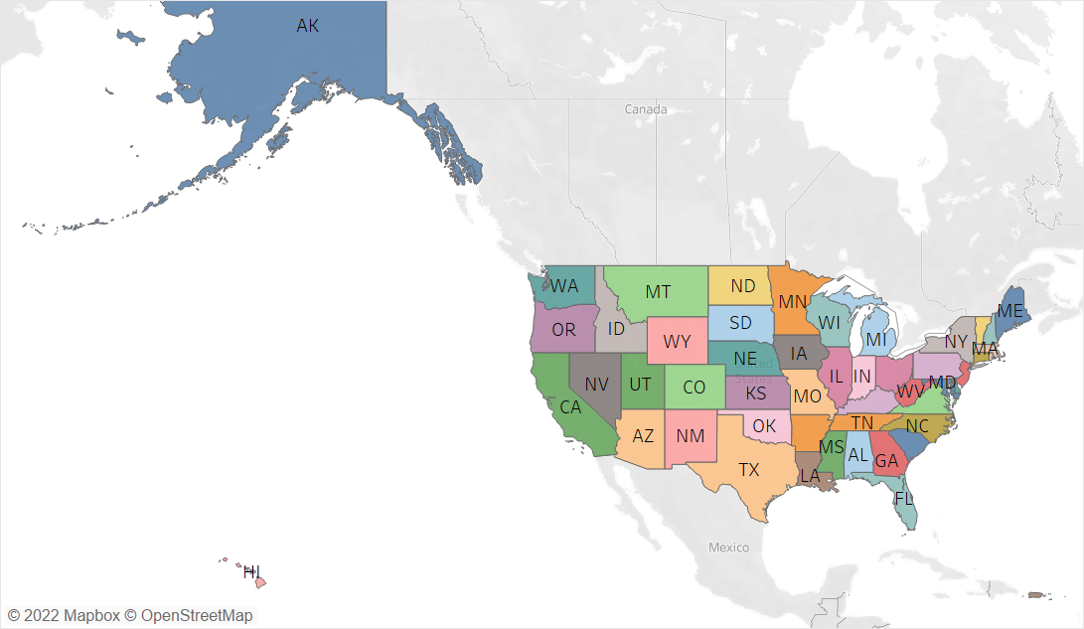
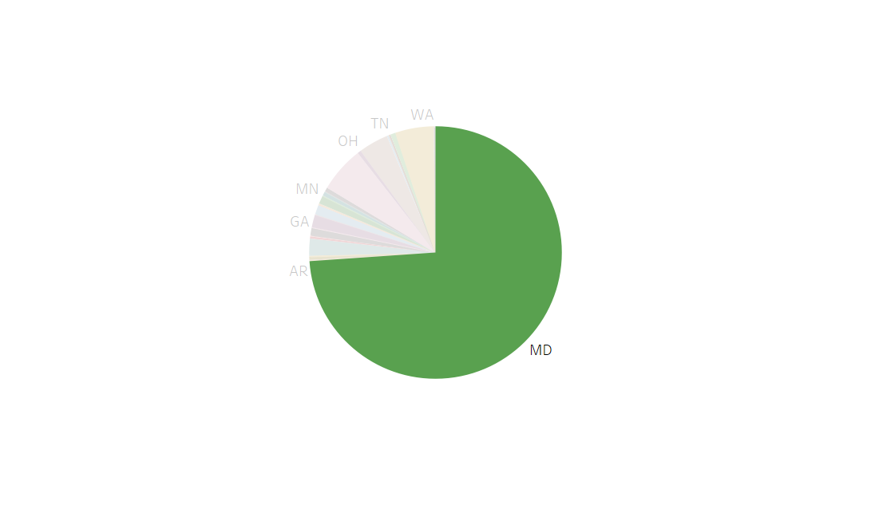
Maryland State Vendor distribution spreads all across USA
On an average,Maryland State Agencies spend 73.8% of their
funds on Local Vendors, which is around $20 Billion.
MD State agency vendors spread across 53 regions, which include all the 50 states of US along with Washington DC, Puerto Rico & Virgin Islands.

Slide 14
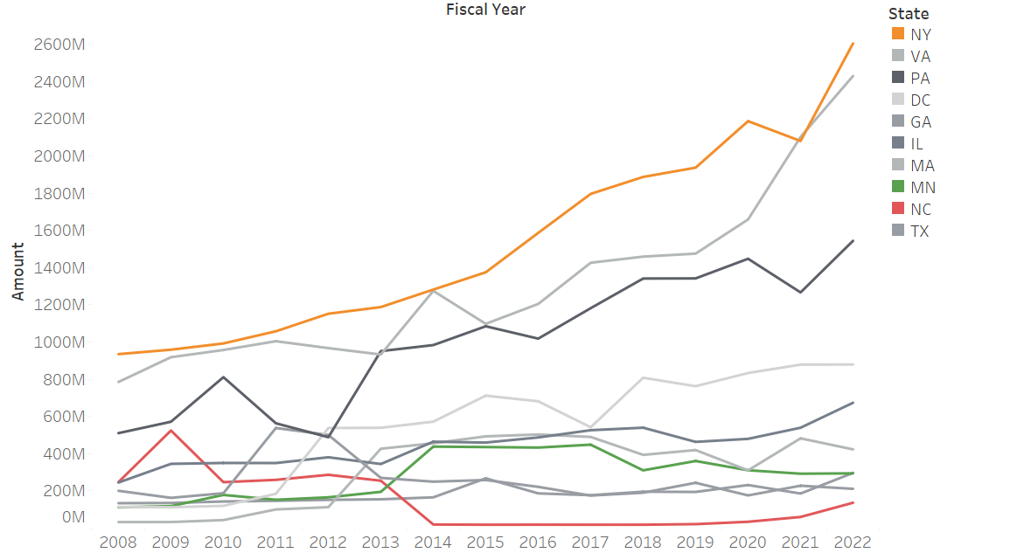
New York, Virginia, Pennsylvania, and Washington DC follow Maryland in the % total fund utilization

Slide 15


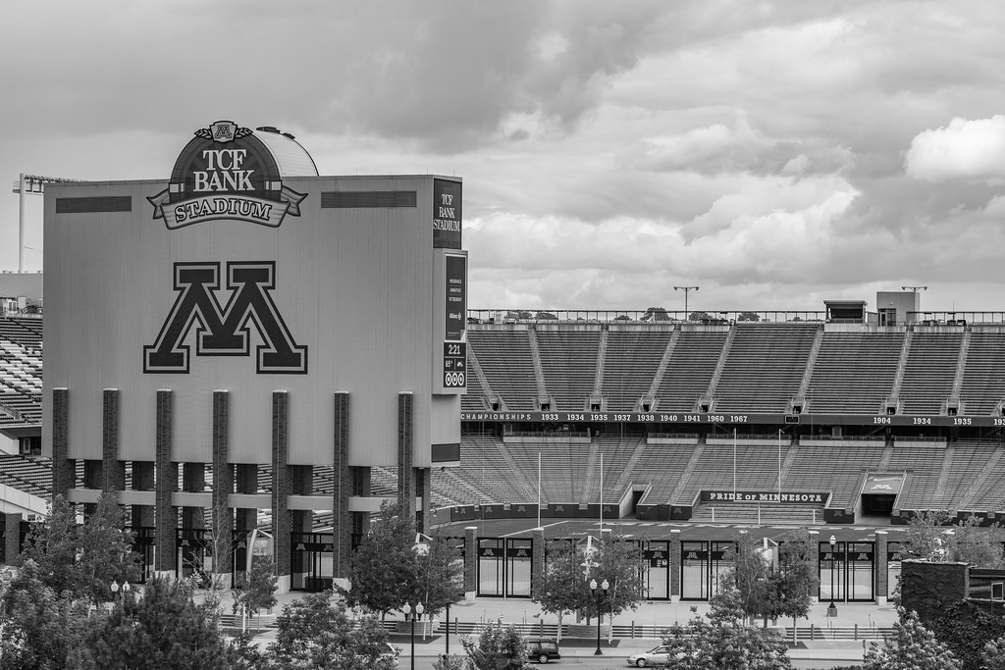

Observations :
On an average, 99.5% funds from the “REDEMPTION AND INTEREST OF STATE BONDS” Agency are spent on New York based vendors
During the period 2012 - 2014 Minnesota has taken away $270M worth “COMPTROLLER OF MARYLAND” Agency project from North Carolina as US Bank took over the project from Bank of America
Notes:
1) Debt payment ( Fin. Institutions)

Slide 16
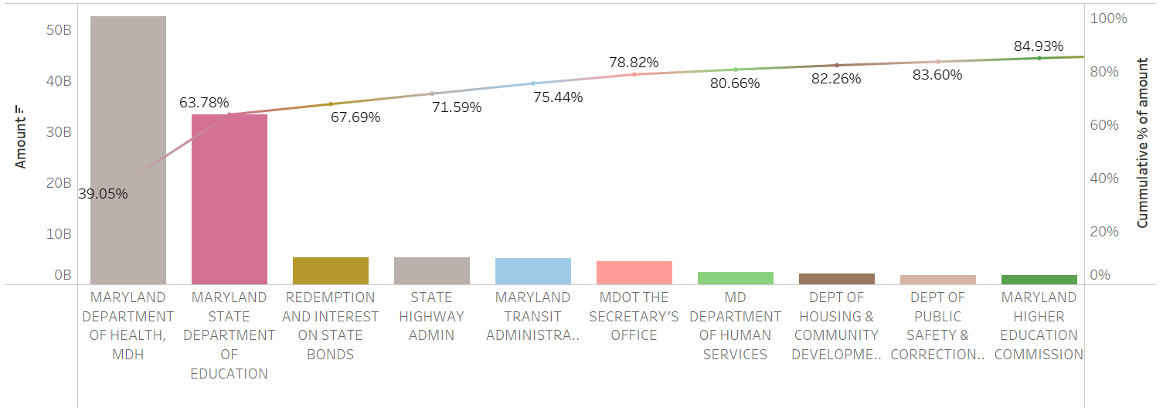
The top 5 agencies contributed 76% of the total amount spent in the last 15 years, with the Department of Health and Department of Education contributing 64%.

Slide 17
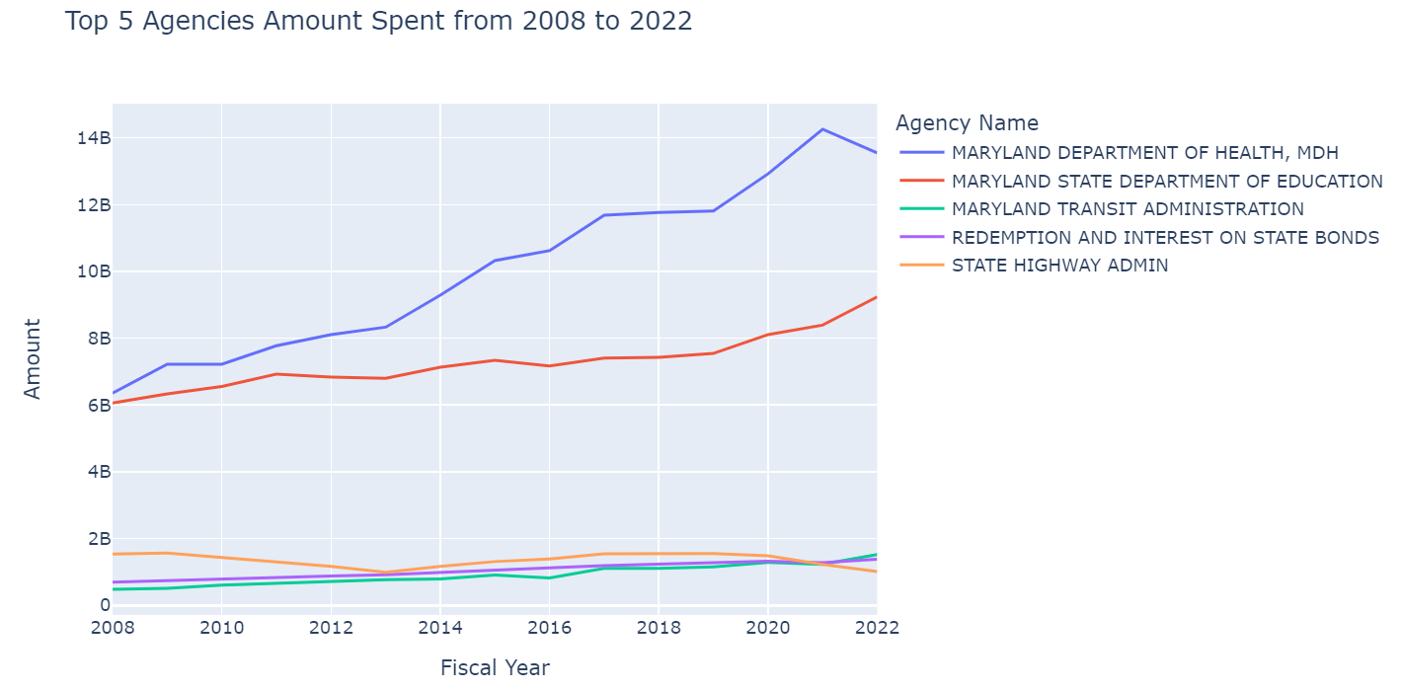
Health and Education are definitely given higher importance in Maryland

Slide 18
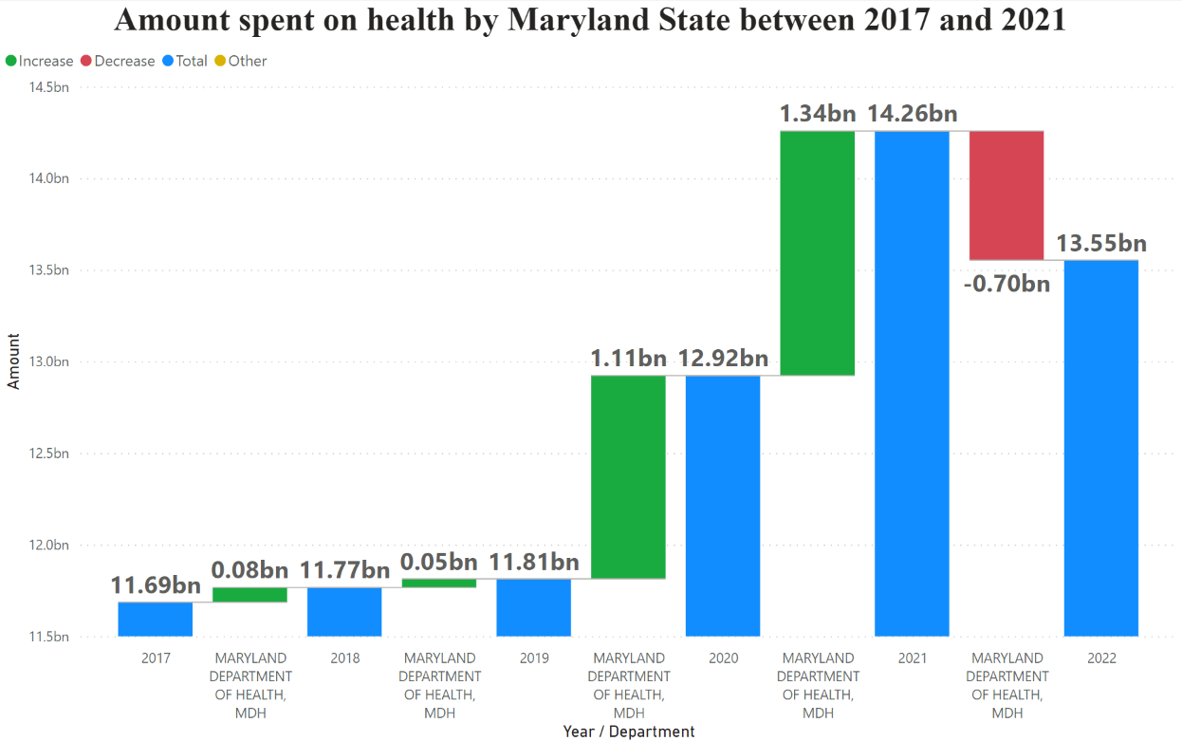
During COVID the amount spent on health has increased by 20 times compared to previous years.

Slide 19
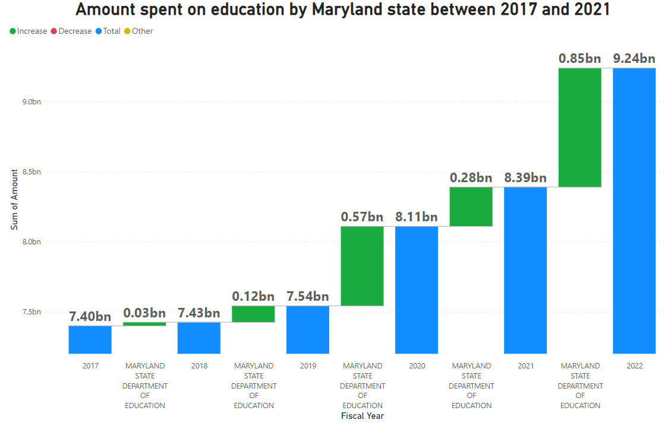
The amount spent on education has also increased during the COVID times

Slide 20
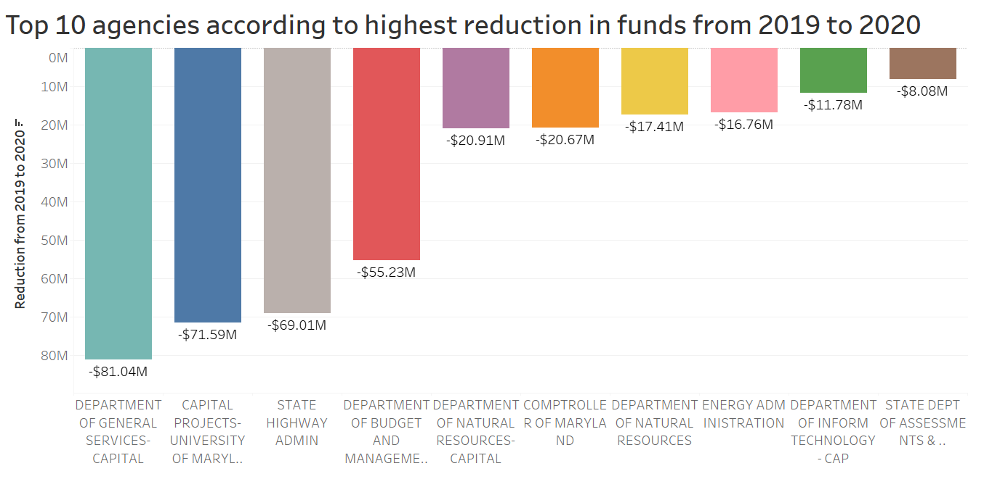
Reduction in the amount spent from 2019 to 2020 for various agencies

Slide 21
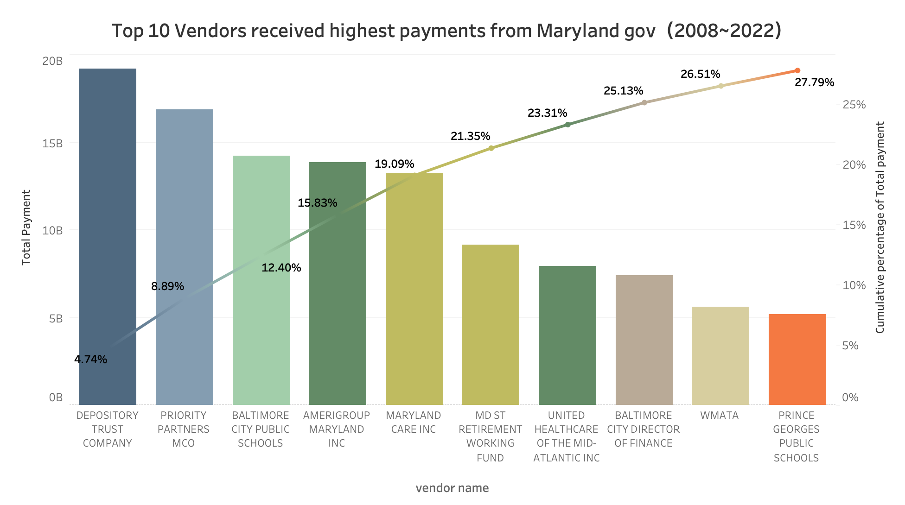
From 2008 to 2022, the top 5 vendors received 19% of the total money spent
Top 5

Slide 22
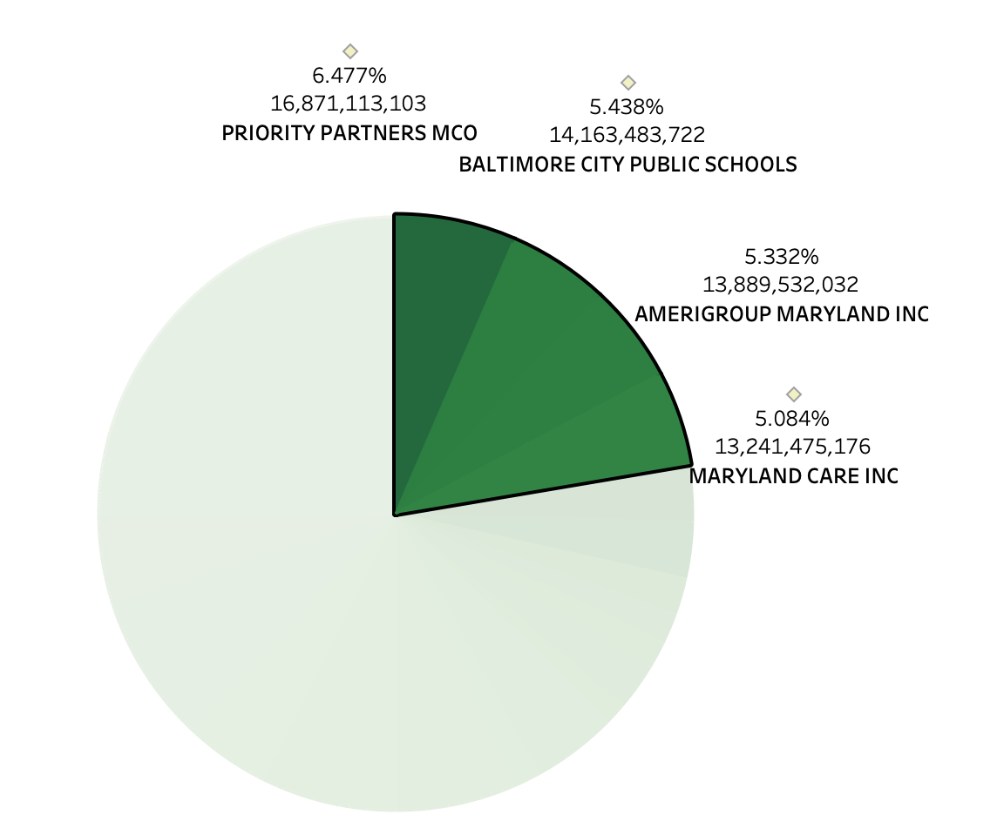
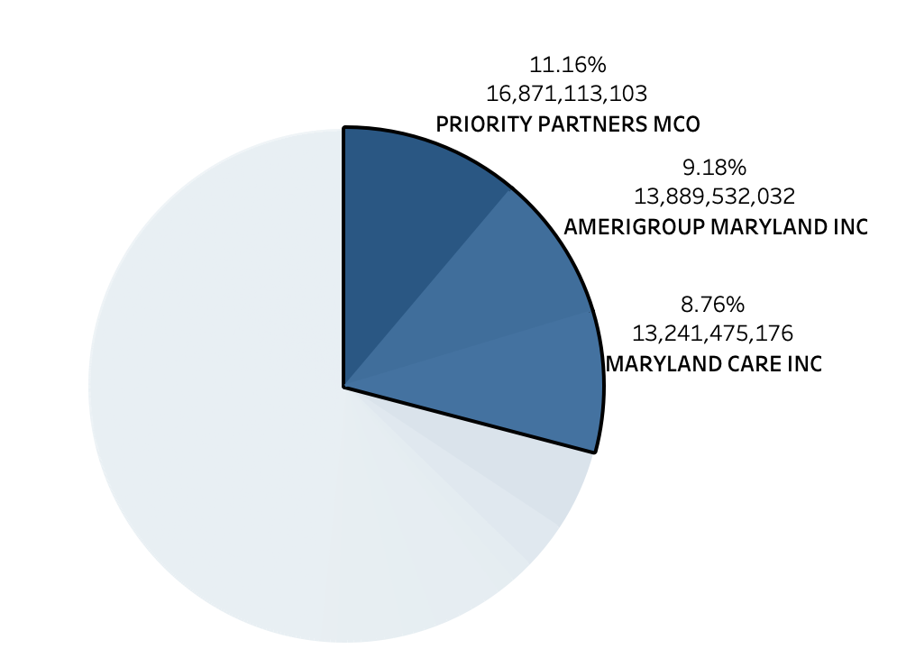
MDH spent 29% of money while MDE spent 22% that going to
Top 5 vendors with highest payment from Maryland Government
Payment distribution of MDE by vendors
Payment distribution of MDH by vendors

Slide 23

04.
OUR
Conclusion
//0507 TEAM 5
MARYLAND PAYMENT EDA

Slide 24

Conclusion
//0507 TEAM 5
In 2024, it is projected that the Maryland budget will be $39B, trending with state deficit amount
74% of the funds are spent on Local Vendors
64% of the money is spent on Education and Health, which is a good sign.
Univ. of Maryland funds are reduced during Covid.
AmeriGroup and Priority partners received most of the funds.
MARYLAND PAYMENT EDA
Notes:
Fascinating to see the transparency

Slide 25
Future Scope
//0507 TEAM 5
In-depth data for the amount spent in lower levels will give more understanding of amount spent
Break down of transactions by month/quarter will give inferences on seasonality of expenses
Data on income levels/outcomes of agencies will give information to prepare better public policies
Information about minority owned vendors
MARYLAND PAYMENT EDA
Notes:
Fascinating to see the transparency

Slide 26
Question & Answers
//0507 TEAM 5
MARYLAND PAYMENT EDA

